Slide 1
Accelerated pyramid
Making gsky faster
Status update on: 22 Aug, 2019

Slide 2
purpose
To be able to view at continent zoom levels.
Faster displays.
To be used with other WMS clients.
QGIS, ArcGIS, Google Earth and NASA WorldWind.
KMLs that call the PNGs or GSKY are to be generated.
To The Demo…

Slide 3
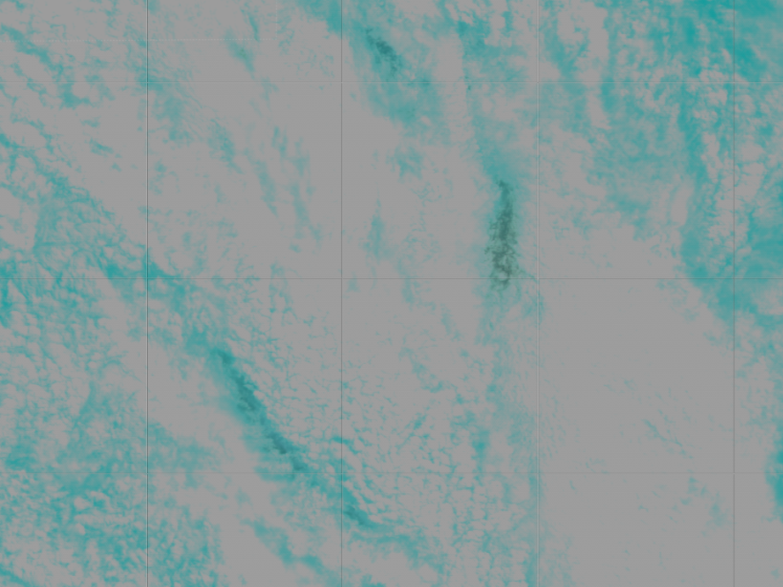
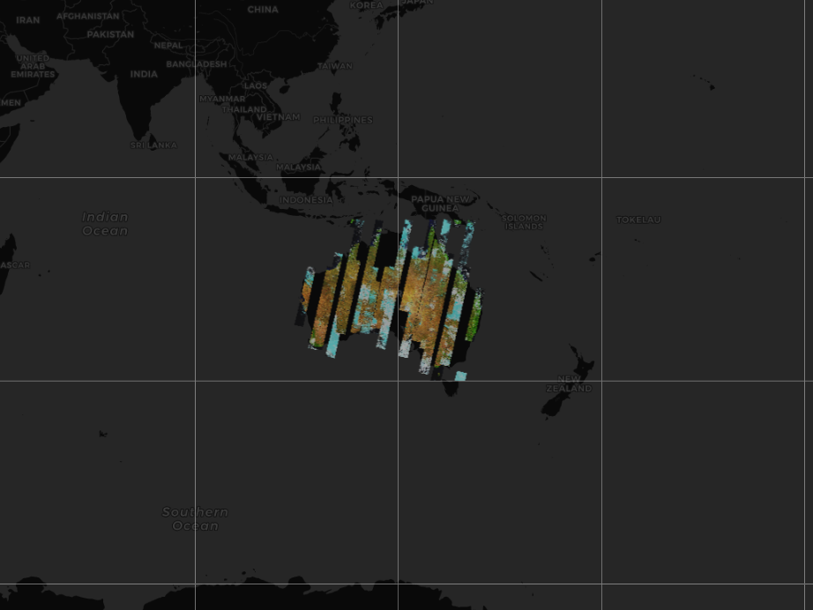
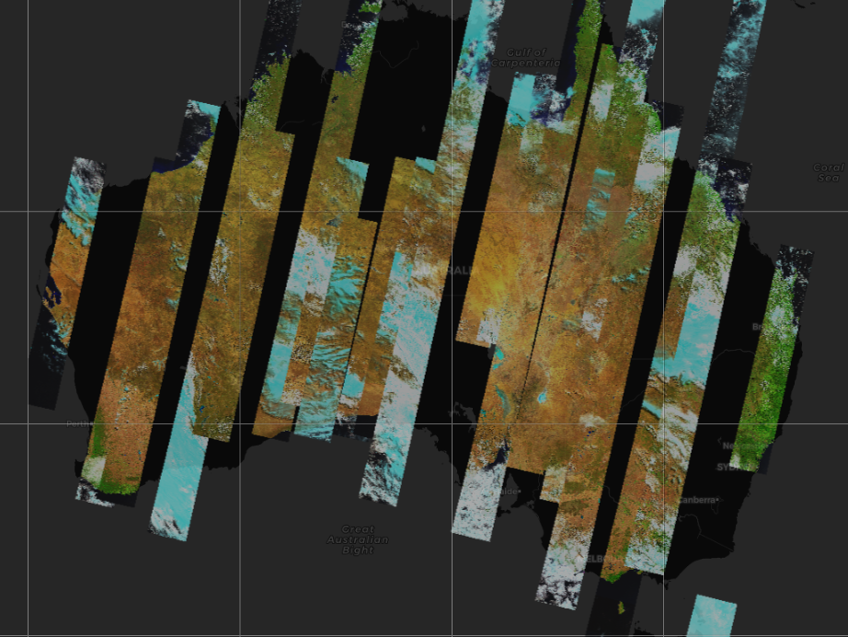
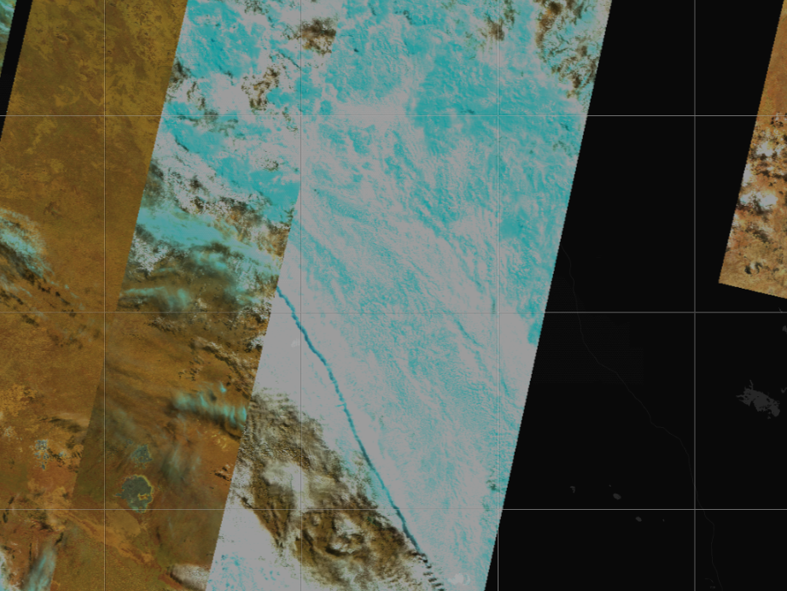
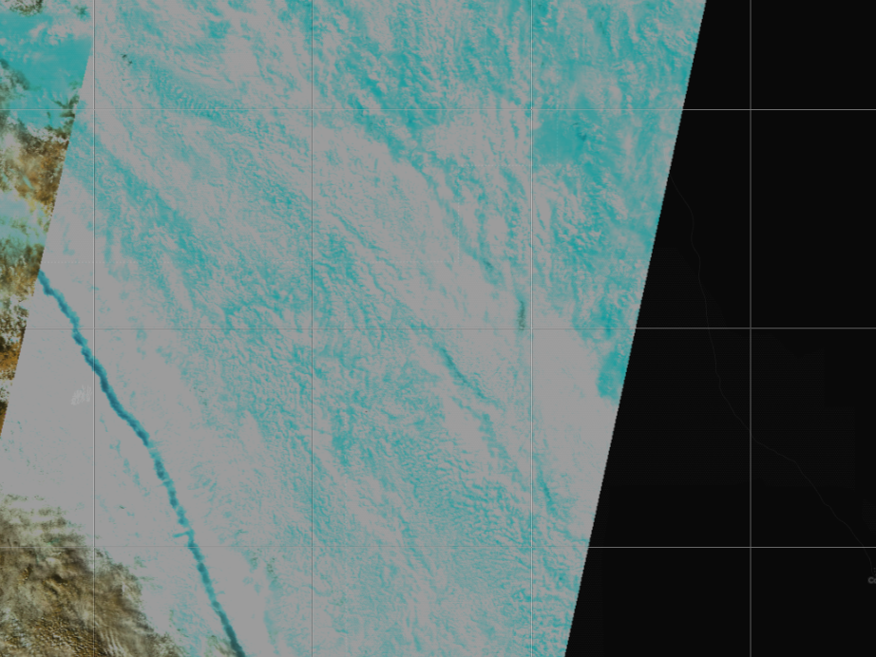
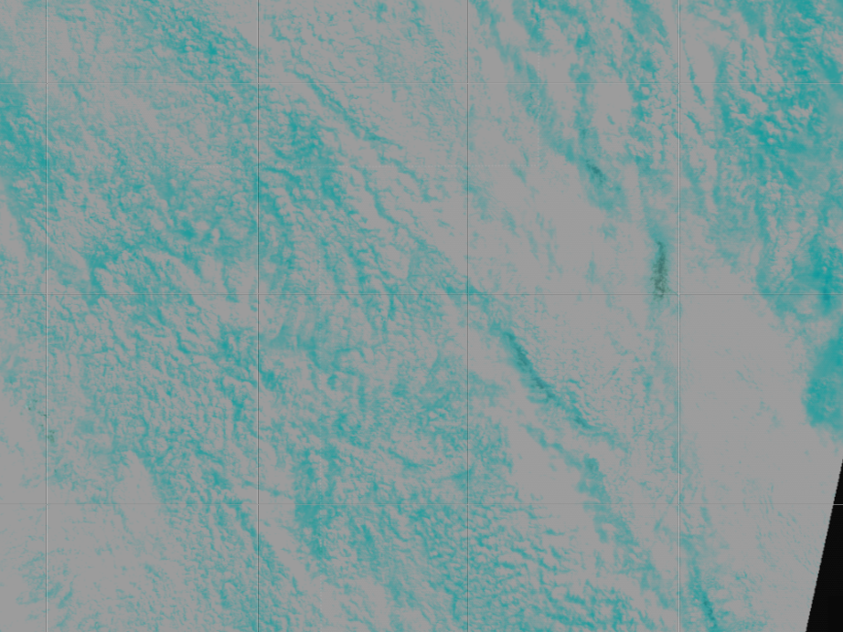
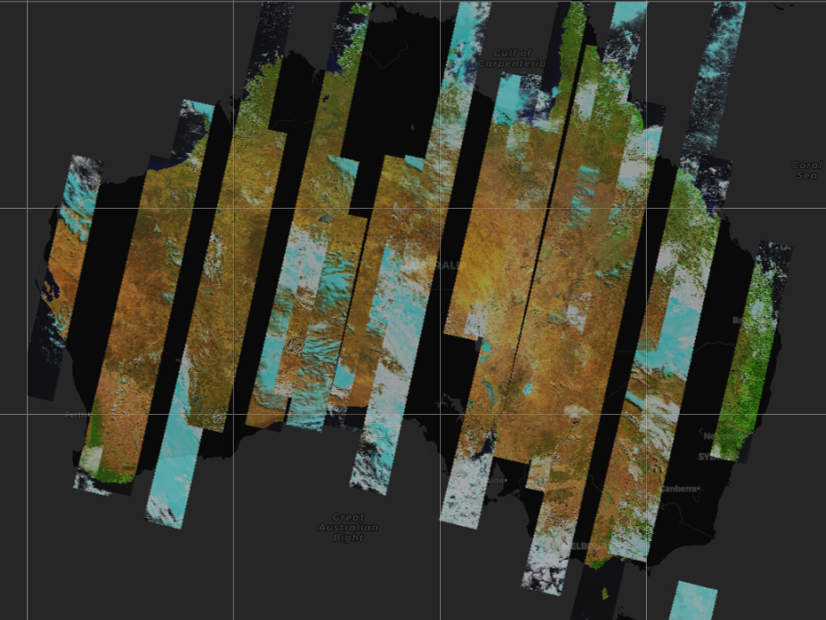
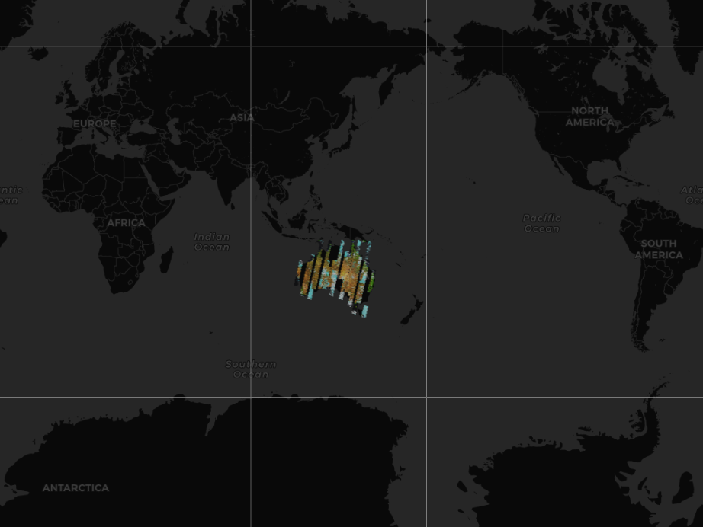
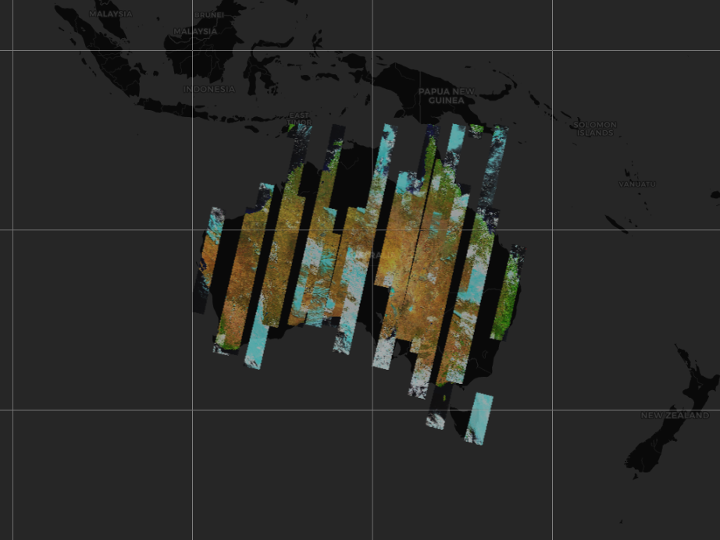
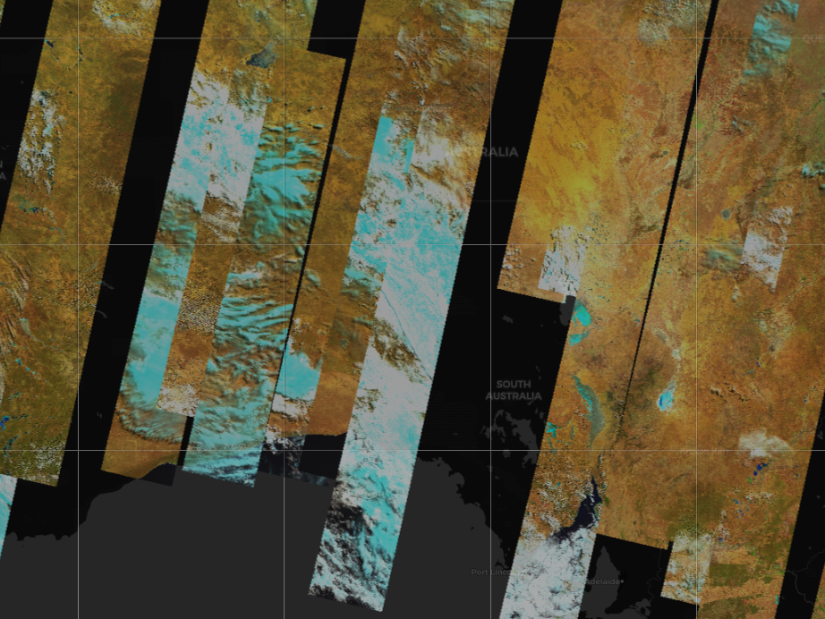
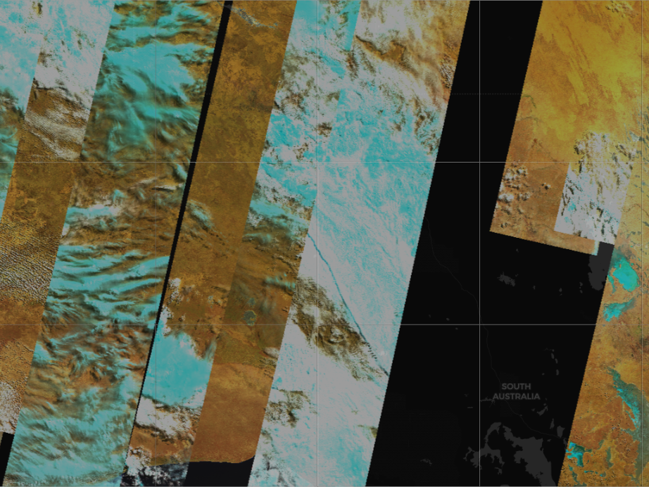
16-day DEA Landsat 8 surface reflectance – 19/03/2013
View this as a slide show.
Click mouse to animate.

Slide 4
limitations
Only suitable for Terria and other WMS clients.
ArcGIS and QGIS are to be tested.
These require continent level display.
Not suitable for scripts.
Non-standard bounding boxes.
Too many tiles to cache.
Excessive processing time and storage space.

Slide 5
solution
Cache only the building blocks.
Create the tiles for a high zoom level alone (say, 10 km)
Create a tile on the fly.
Concatenate 4 images and resize to form the next lower zoom level.
16 for next, 64 for the one after and so on.
This will cater for all zoom levels in Terria.
Crop smaller tiles from a larger one.
This will cater for the non-standard bounding boxes in scripts.

Slide 6
challenges
Must work for scripts and all WMS clients.
Creation of tiles on the fly should not take too long.
Conversion of coordinates from EPSG:4326 to EPSG:3857
Scripts send as EPSG:4326, whereas Terria sends as EPSG:3857.
Now using external Python scripts for the conversion.
Must investigate GO functions for it.
There are some minor disparities during the conversion.

Slide 7
Logic and algorithm
Change the GSKY server code to reconstruct a tile.
Determine the enclosing bbox from the incoming bbox values.
Find or create a tile for the enclosing bounding box.
Calculate the offsets of the smaller tile.
Crop from the larger tile, re-page and re-size to the small tile.
Logic was tested manually and it works.
The algorithm is nearly completed.
To The Demo…

Slide 8
The way to build large and subset tiles from small building blocks
Build the 10km zoom level tiles for a layer and time slice. (6,254 tiles; 665M)
Use ImageMagick to build a 20km tile as follows.
1
2
1. convert 1.png 2.png +append 1-2.png
2. convert 3.png 4.png +append 3-4.png
3
4
3. convert 1-2.png 3-4.png -append 1234.png
3. Crop an area to make small tiles
convert 1234.png -crop 256x256+128+128 +repage 5.png
4. Resize a smaller tile to 256x256
convert 1234.png -crop 128x128+192+192 +repage 6.png
convert 6.png -resize 256x256 7.png
See next slide for examples. View it as a slide show.

Slide 9

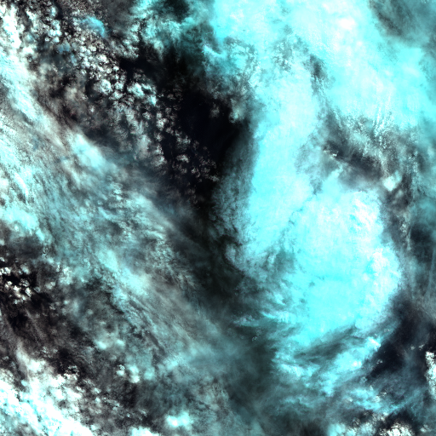
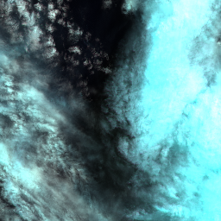


Manually created tiles to develop the logic. Must view as a slide show.
128x128 cutout Resized
512x512 Actual size; Created from 4 x 10km tiles
256x256 cutout. Actual size
20km tile from 4 x 10km tiles.
128x128 cutout. Actual size
Notes:
Test

Slide 10
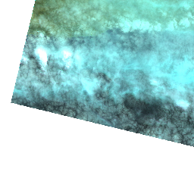


Created by the GSKY code.
Must view as a slide show.
Enclosing tile (cached or compiled from building blocks)
Resized to fit the dimensions in the call
Still to do:
Calculate the offsets to create tiles
Handle both EPSG:3857 and EPSG:4326
Requested BBOX (Not cached)

